Slide 1
Comparative Analysis of ML Algorithms for Early Detection of Kidney Diseases
IDP 14001
Presented by:
Pratyasha Basak- UG/02/BTCSE/2023/181 Rohan Manna- UG/02/BTCSE/2023/184
Suvankar Roy- UG/02/BTCSE/2023/188

Slide 2
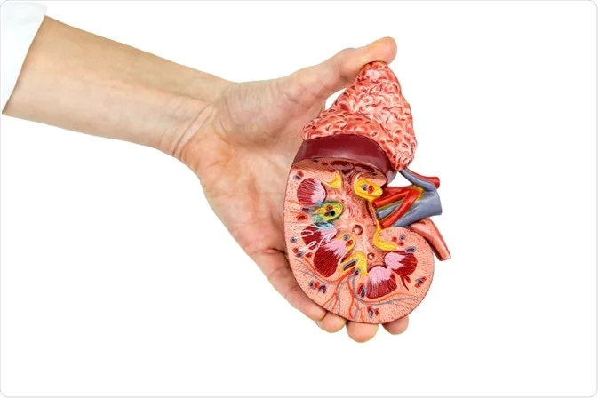
Content

Slide 3
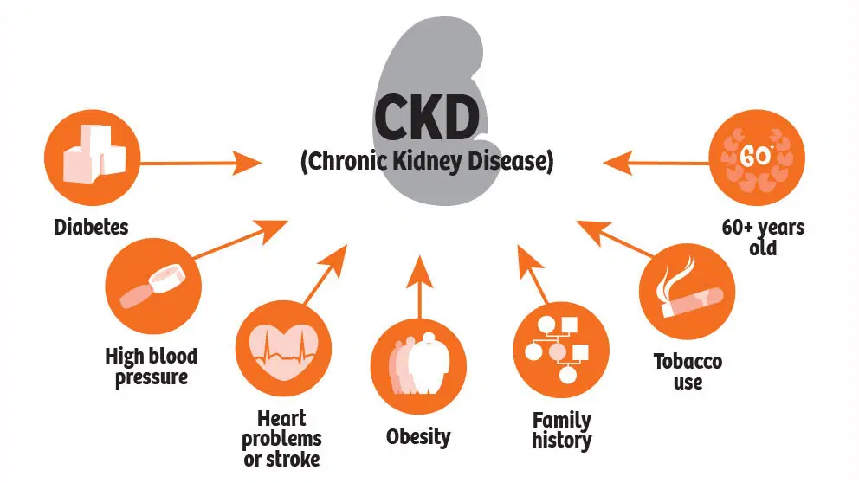
INTRODUCTION
Chronic kidney Disease (CKD) means your kidneys are damaged and not filtering your blood the way it should. The primary role of kidneys is to filter extra water and waste from your blood to produce urine and if the person is suffering from CKD, it means that wastes are collected in the body. This disease is chronic because of the damage gradually over a long period.
CKD is predicted through the below tests:
Blood Tests (Estimated Glomerular Filtration Rate (eGFR),
Serum Creatinine Test)
Urine Tests (Urinalysis, Albumin-to-Creatinine Ratio (ACR),
24-Hour Urine Test)
Imaging Tests CT Scan (Computed Tomography), MRI (Magnetic Resonance Imaging))
Blood Pressure Measurement
Electrolyte and Mineral Tests (Serum Electrolytes (Sodium, Potassium, Calcium, Phosphate))

Slide 4
Background
Global Health Concern
Kidney failure is a significant health issue, characterized by the kidneys' inability to filter blood effectively, leading to fluid and waste buildup.
Delayed Diagnosis
CKD often goes undetected until advanced stages due to a lack of early symptoms, complicating treatment options.
Machine Learning Application
Extensive research is focused on using machine learning (ML) techniques for predicting CKD, which shows promise in healthcare for disease detection and diagnosis.
ML Models Used
Various ML models such as Support Vector Machine (SVM), Decision Tree (DT),Random Forest (RF), and K-Nearest Neighbor (KNN) etc are employed to improve predictive accuracy.
Data Utilization
The effectiveness of different attributes from established databases and real-world datasets is explored to enhance prediction accuracy.
Conclusion
Utilizing comprehensive real-life datasets with relevant attributes significantly improves the accuracy of CKD predictions through machine learning models.

Slide 5
OBJECTIVE
Early Detection:
One of the main aims is to enable early diagnosis of CKD, a condition that often shows no symptoms in its early stages. This asymptomatic nature leads to diagnoses only in advanced stages, where treatment options become limited. Early detection can significantly improve patient outcomes.
Comparative Analysis of Machine Learning Algorithms:
This paper will evaluate and compare the performance of various machine learning techniques, including Decision Trees, Random Forests, Support Vector Machines, and K-Nearest Neighbors. The goal is to determine which models are most effective at predicting CKD using different datasets.
Boosting Predictive Accuracy:
By systematically analyzing different machine learning models and incorporating extensive real-world datasets, the project aims to achieve high accuracy in CKD predictions. This improved accuracy can support timely medical interventions, ultimately contributing to better healthcare outcomes.
IDP 14001

Slide 6
TECHNOLOGY USED
Data Sources
Public Datasets: Using publicly available datasets related to kidney diseases from Kaggle.
Programming Language
Python: a popular programming language for data analysis and machine learning
Integrated Development Environment (IDE)
Visual Studio Code: Popular IDE for Python development.
Data Manipulation and Analysis
Pandas: Used for data manipulation and analysis
Functions like pd.read_excel(), data.head(), data.info(), and data.describe() are used for loading and exploring the dataset.
Numerical Operations
NumPy: Used for numerical operations and handling arrays

Slide 7
Machine Learning
Scikit-learn:
It provides tools for model selection, evaluation, and preprocessing.
train_test_split: For splitting the dataset into training and testing sets.
StandardScaler: For feature scaling (standardization).
KNeighborsClassifier: The KNN algorithm for classification.
GridSearchCV: For hyperparameter tuning.
classification_report, confusion_matrix, and accuracy_score: For evaluating the model's performance.
cross_val_score: For performing cross-validation.
Data Visualization
Matplotlib:
Used for visualizing the confusion matrix.
Seaborn:
Used to create a heatmap for the confusion matrix.

Slide 8
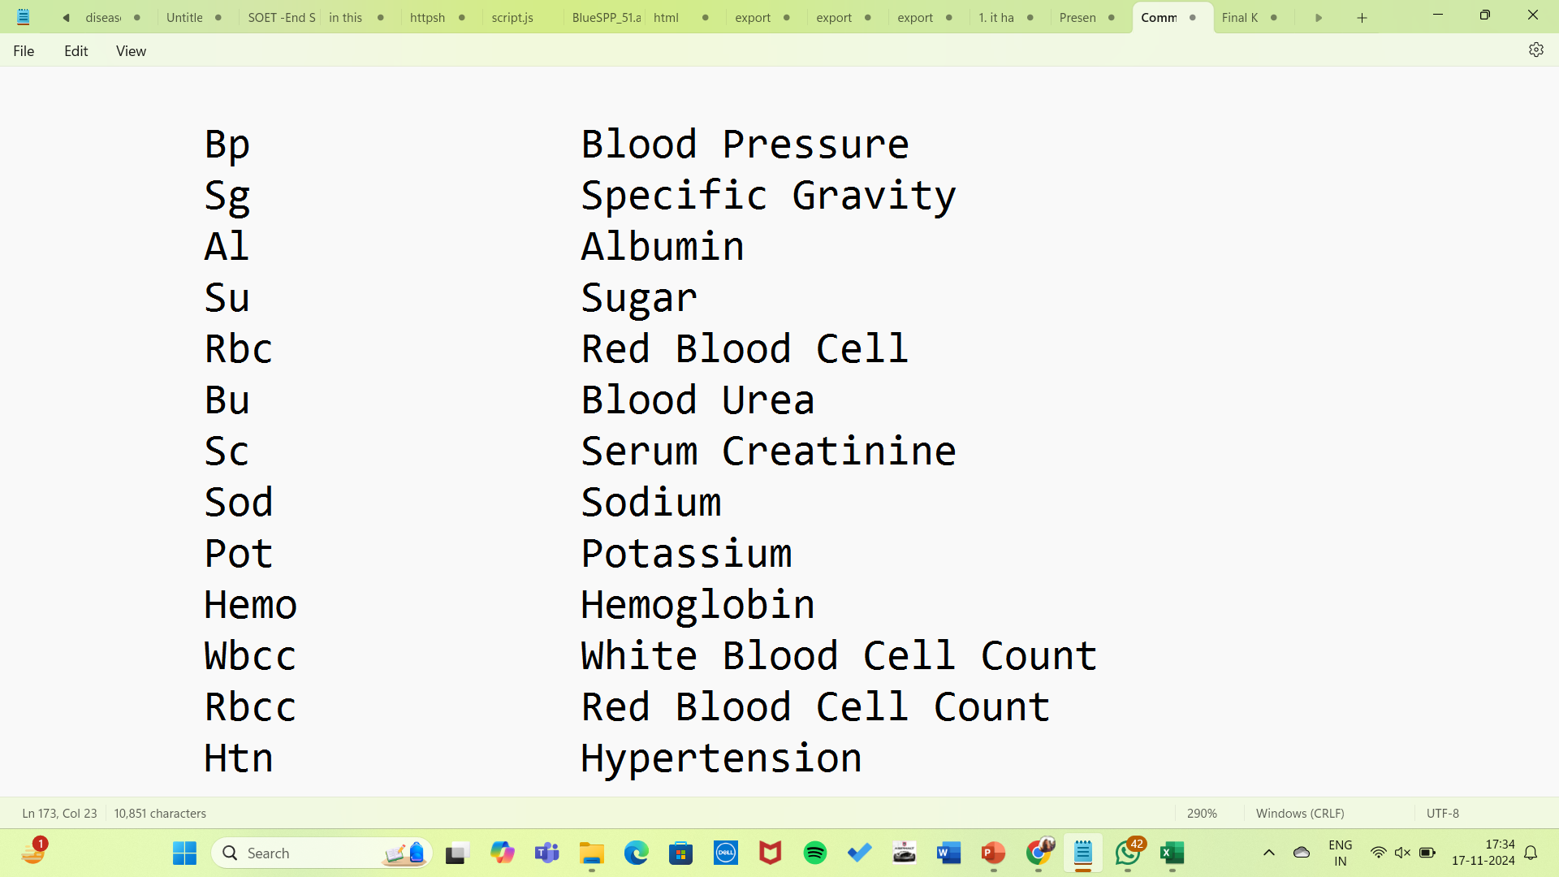
METHODOLOGY
Medical Predictor Variables
In this report, we have developed a model to predict CKD disease in patients. We have used a dataset taken from Kaggle consisting of (13+1) features where the last feature is the “class” which tells whether a person has Chronic Kidney Disease or not.
We have used in total 4 machine learning algorithms namely K-Nearest Neighbor, Support Vector Machine, Decision Tree and Random Forest to display whether a person has Chronic Kidney Disease or not. Thus comparing the output of these 4 models, training them to understand which performs the best of all.

Slide 9
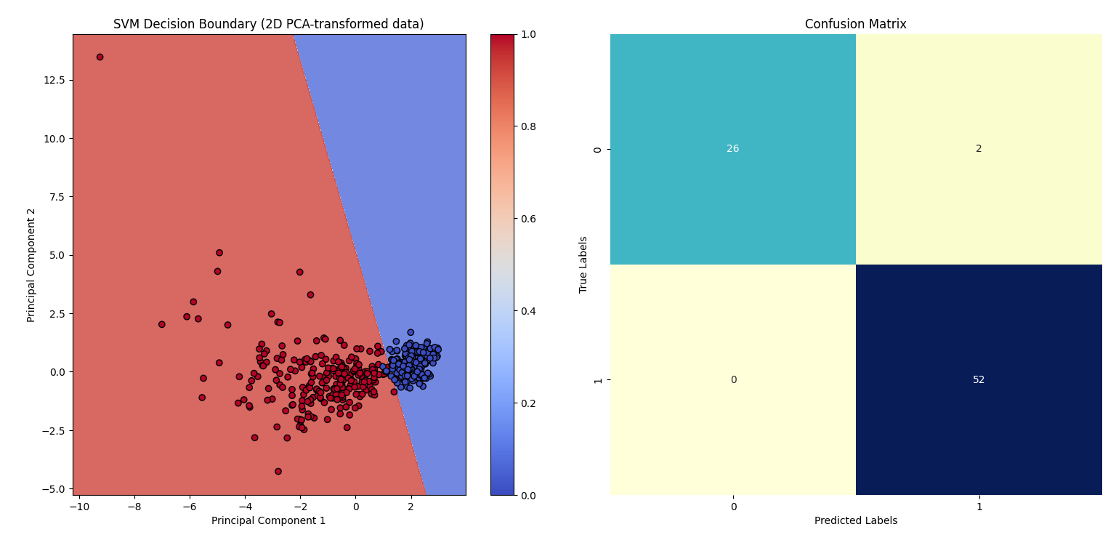
SVM (SUPPORT VECTOR MACHINE)
Support Vector Machine (SVM) is a powerful and popular supervised machine learning algorithm primarily used for classification tasks, though it can also be applied to regression and outlier detection. SVM aims to find the optimal hyperplane that best separates the data into different classes in a high-dimensional space. It is particularly effective for binary classification problems but can be extended to multi-class scenarios as well.

Slide 10
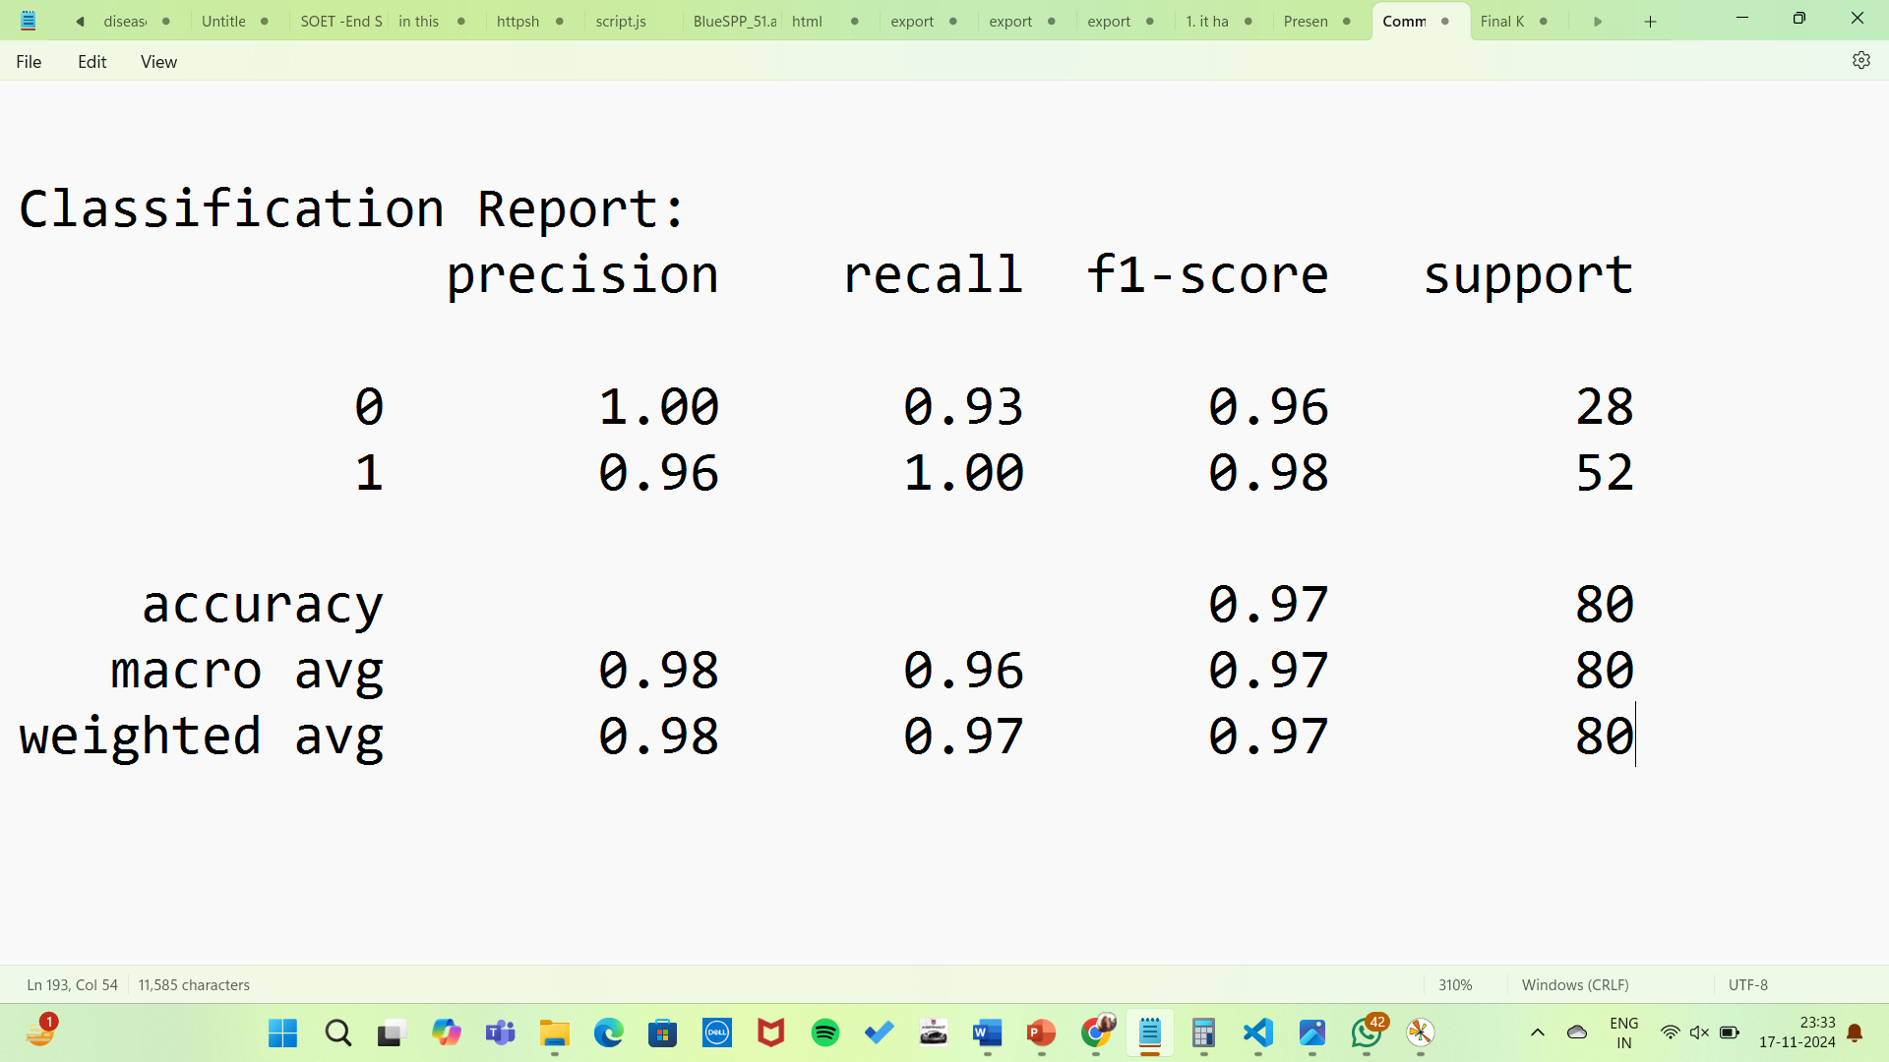
Accuracy on PCA-transformed data: 0.97

Slide 11
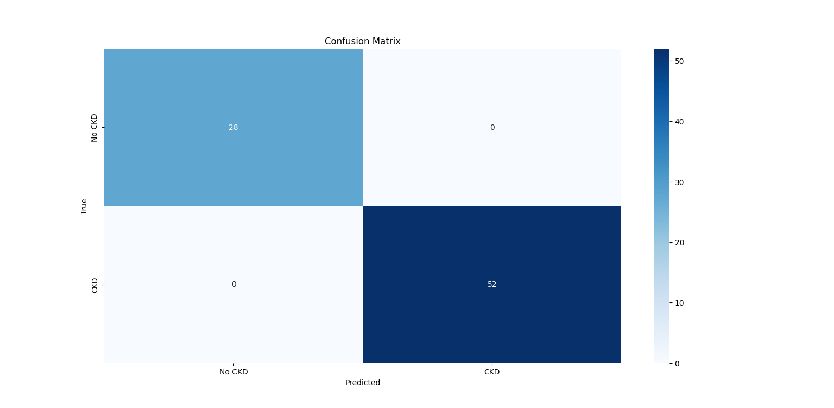
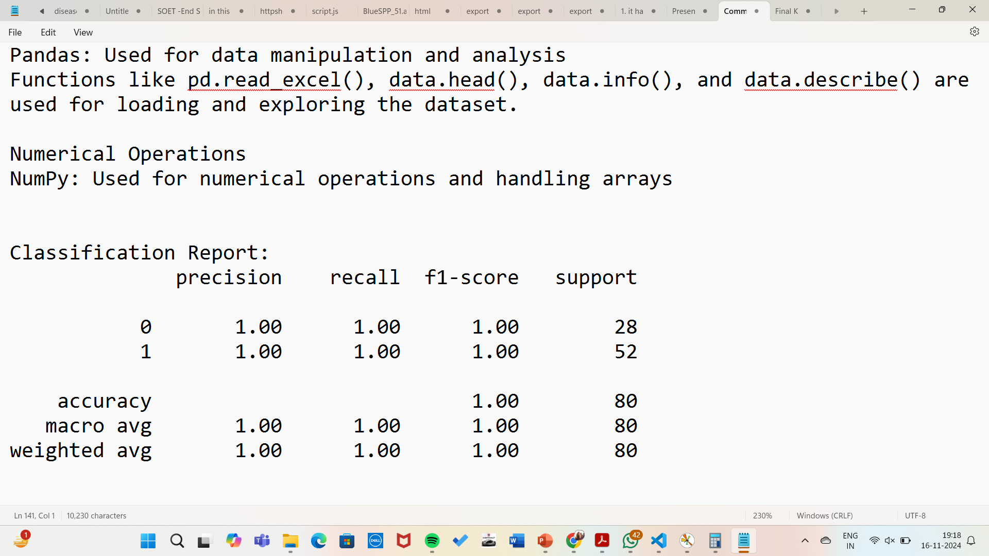
KNN (K-Nearest Neighbor)
The K-Nearest Neighbors (KNN) algorithm is a supervised machine learning algorithm used for both classification and regression tasks. It is one of the simplest and most intuitive algorithms in machine learning. The core idea behind KNN is to classify a data point based on how its neighbors are classified.
Output
Distance Metric: Euclidean distance Best k found: 9
Accuracy of the KNN model: 100.00%
Cross-Validation Scores:
[0.96875 0.984375 0.953125 1.0 0.953125] Mean CV Score: 0.971875

Slide 12
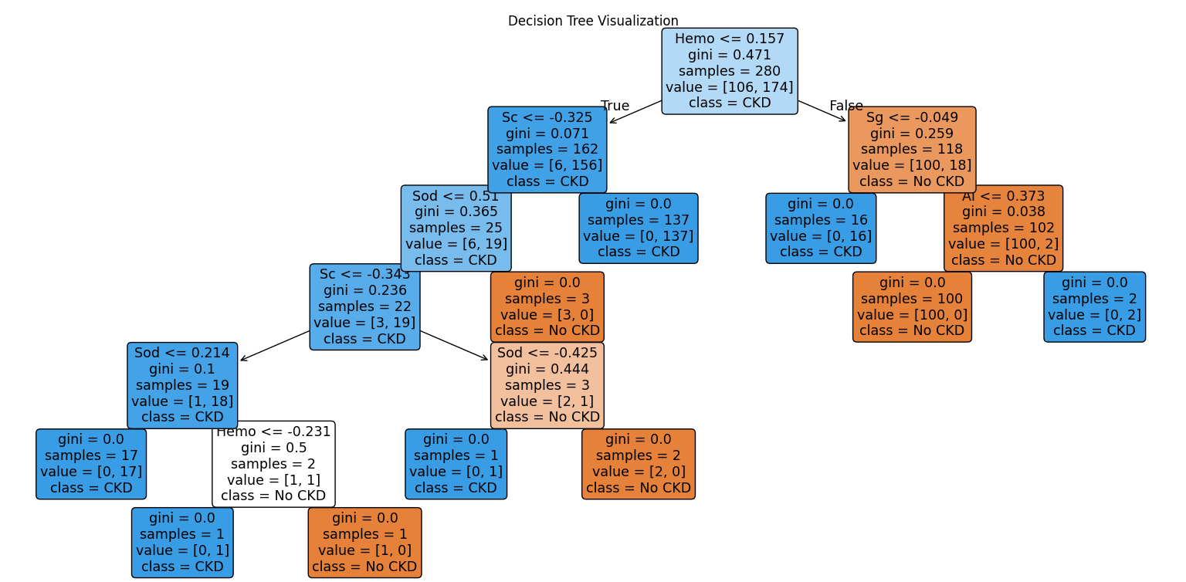
DECISION TREE
A Decision Tree is a popular supervised learning algorithm used for both classification and regression tasks. It works by splitting the dataset into subsets based on feature values, resulting in a tree-like structure of decisions. Each internal node of the tree represents a feature (or attribute), each branch represents a decision rule, and each leaf node represents the outcome (either a class label or a continuous value).

Slide 13
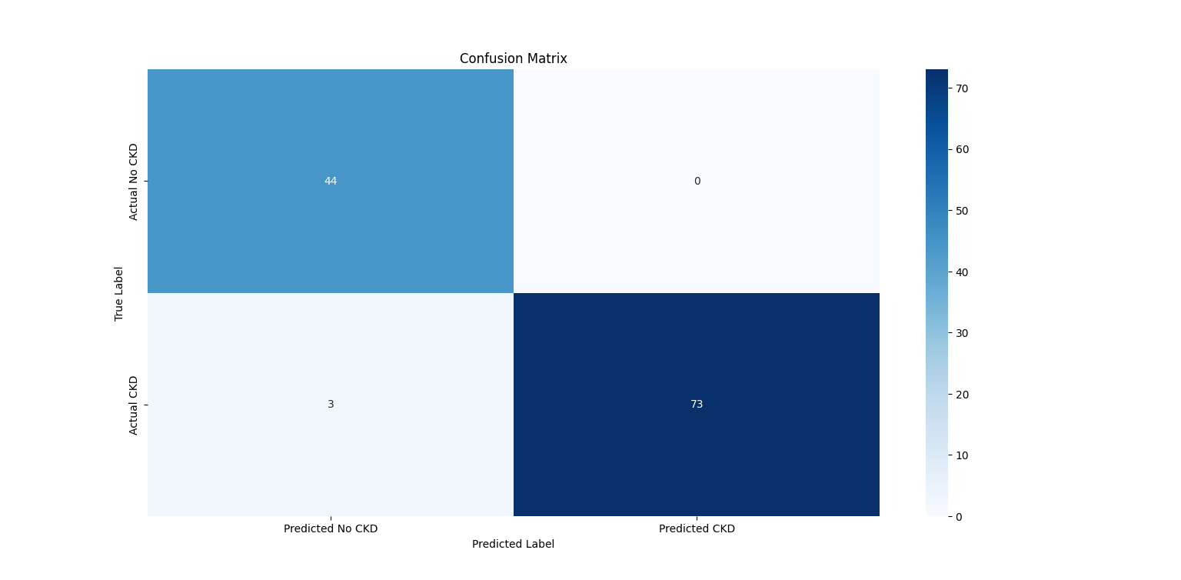
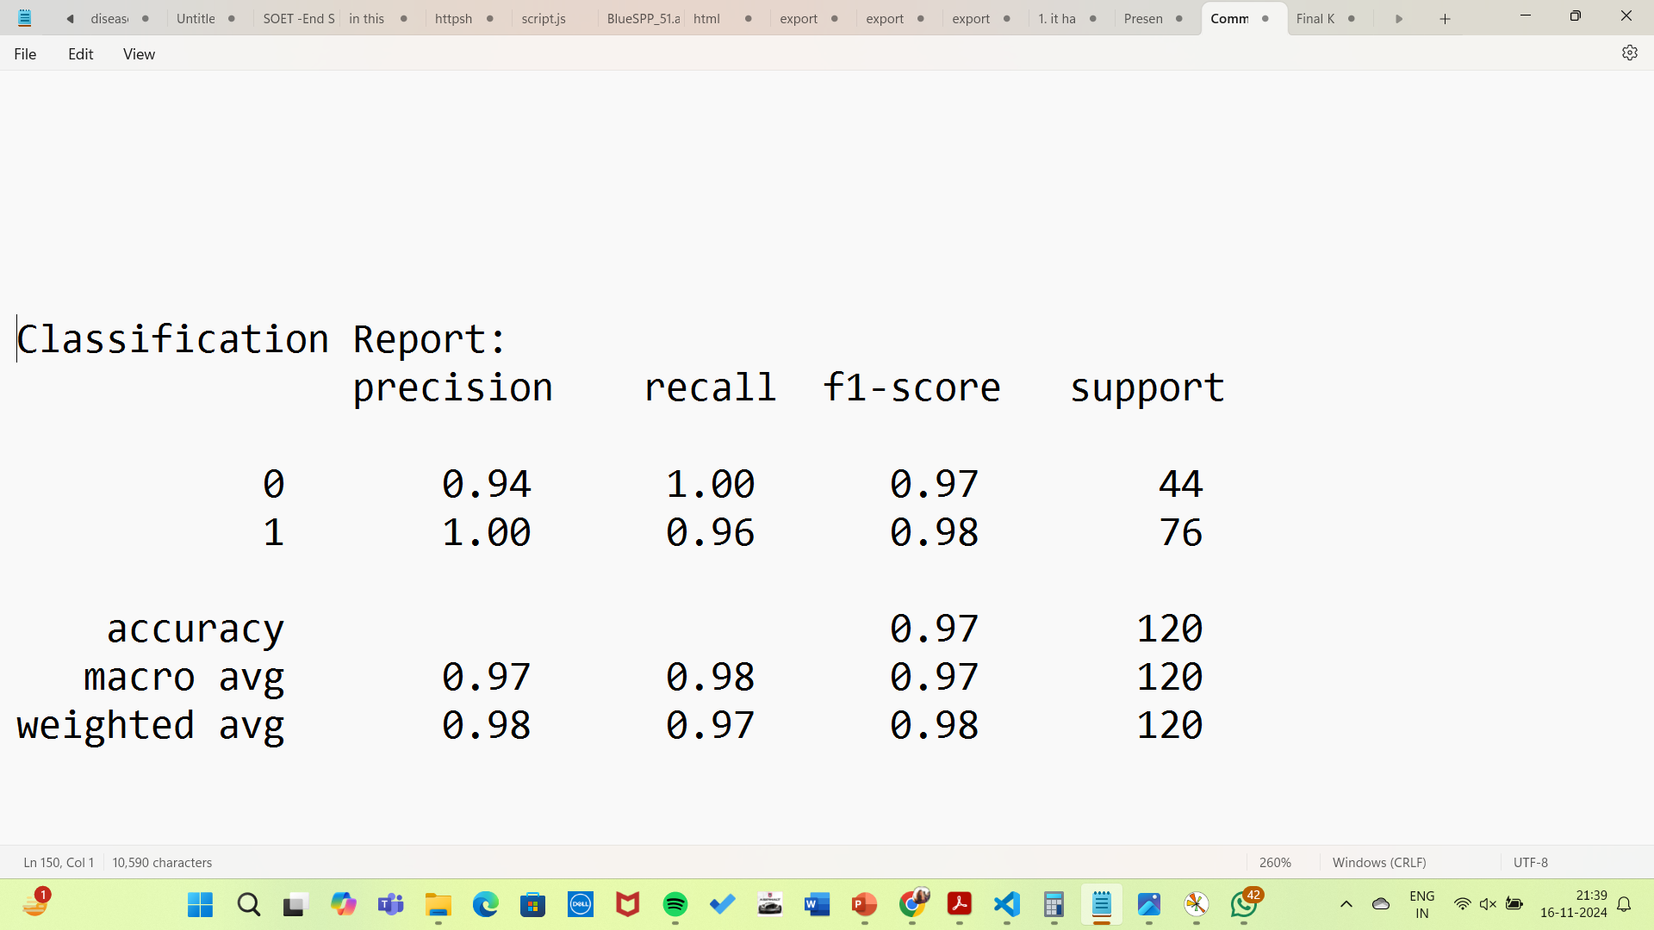
Output Model Accuracy on Test Set: 97% Cross-Validation Accuracy Scores:
[0.95 0.9875 0.95 0.975 0.9875]
Mean Cross-Validation Accuracy: 0.97

Slide 14
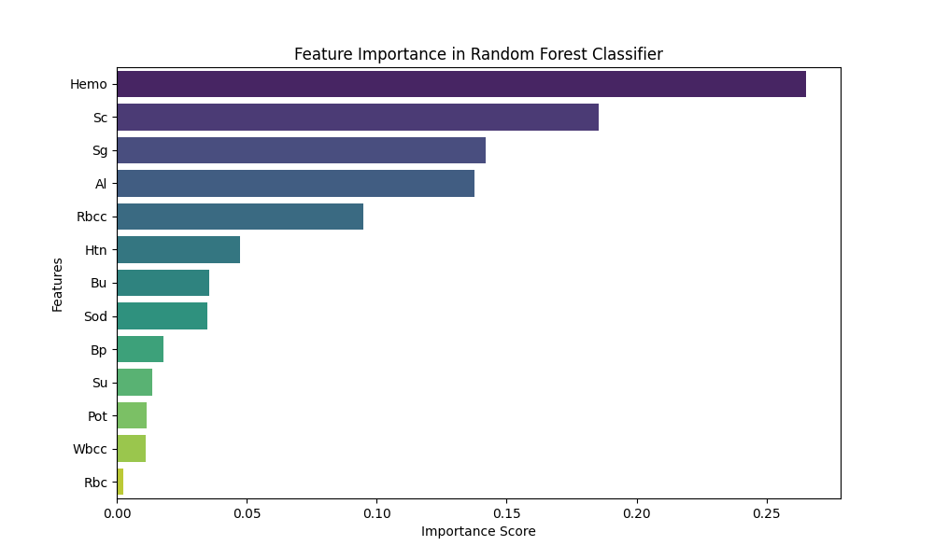
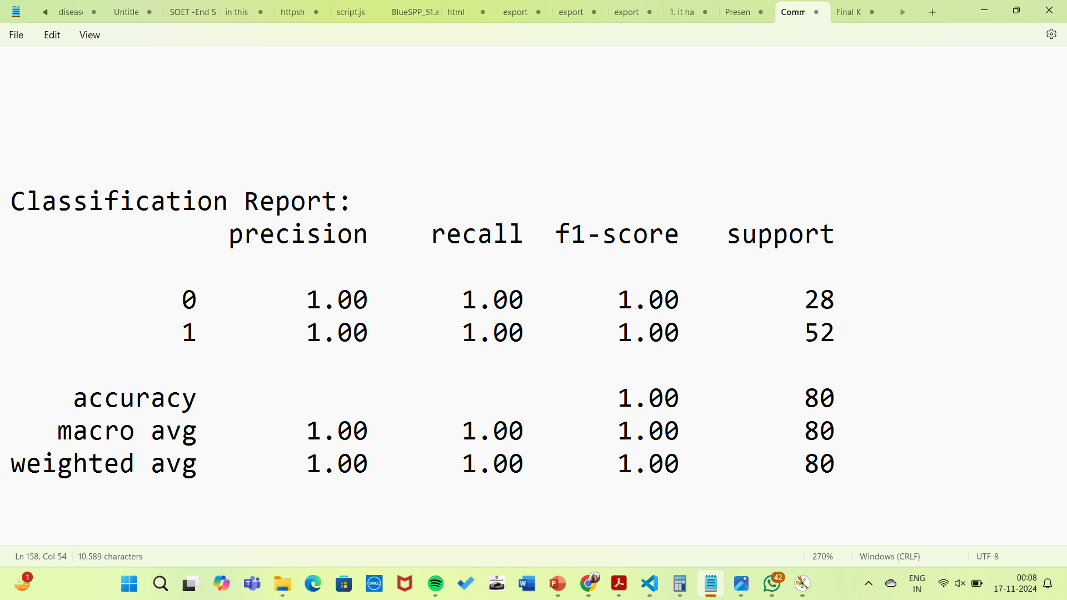
RANDOM FOREST
Random Forest is a popular ensemble learning method in machine learning used for both classification and regression tasks. It is based on the idea of combining multiple decision trees to improve the model's performance and accuracy.
In a Random Forest, the algorithm creates multiple decision trees using different subsets of the dataset. Each tree independently makes predictions, and the final output is determined by either majority voting (for classification) or averaging (for regression). This approach reduces the risk of overfitting and increases the model's robustness

Slide 15
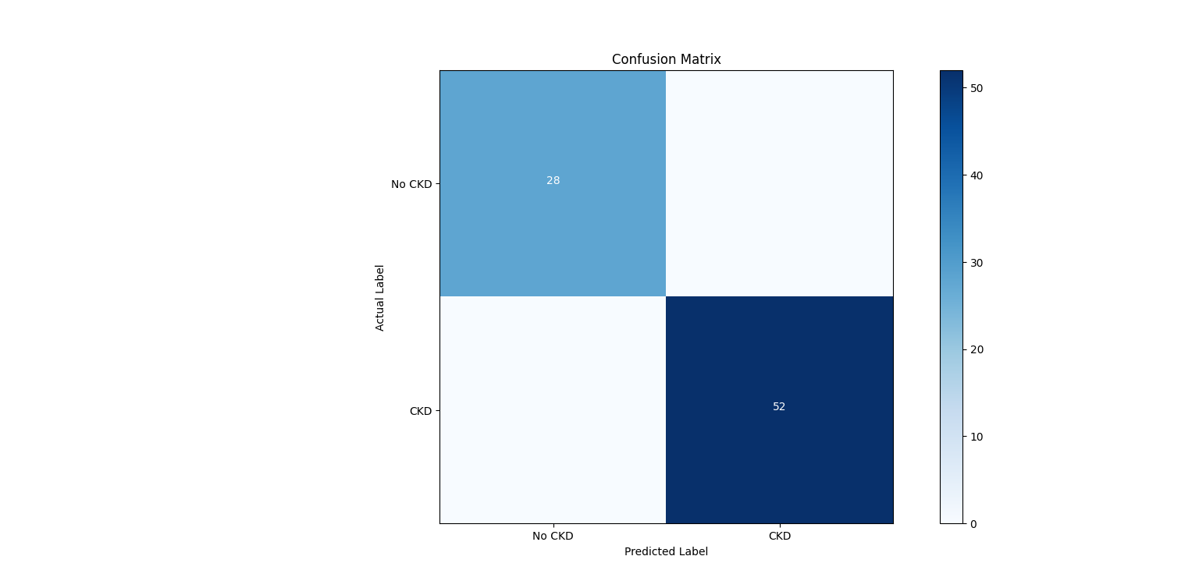
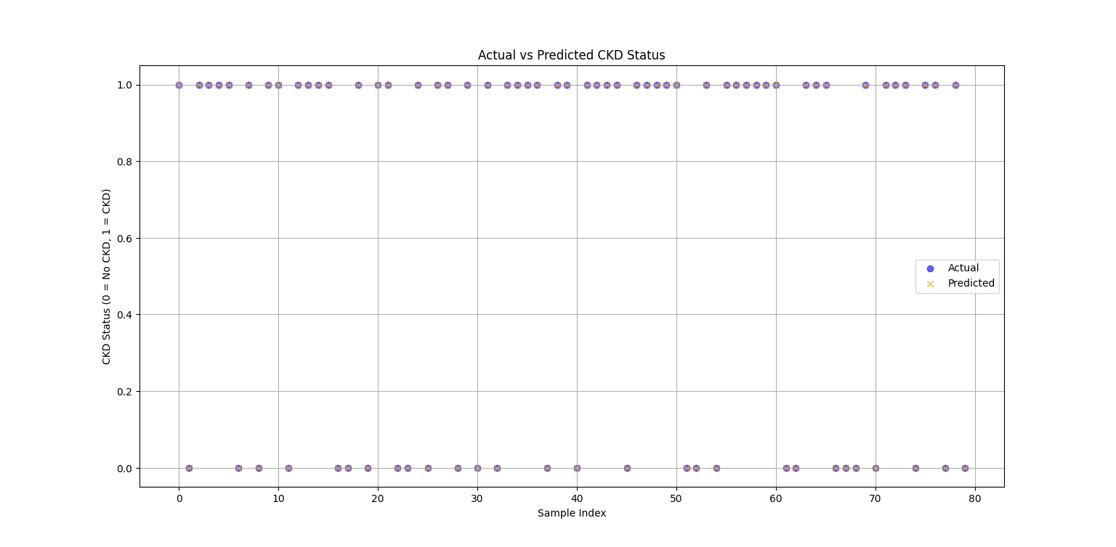
Model Accuracy: 100%

Slide 16
CONCLUSION & RESULT
According to this graph we can see that KNN has the highest accuracy followed by Random Forest.
However, we have worked with only four algorithms and around 13 medical predictor variables hence there may be a different issues like that of overfitting or underfitting and also the case of data quality and the need for clinical validation. Addressing these issues in the near future to attain an accurate model thus translating machine learning models into practical tools that can be integrated into healthcare systems.

Slide 17
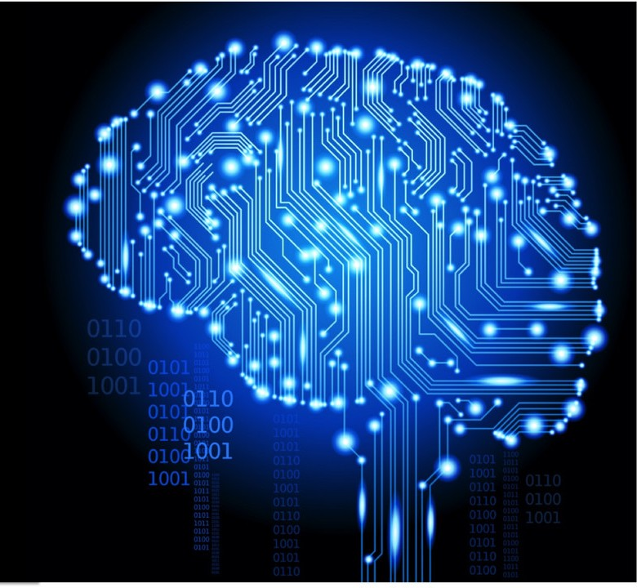
FUTURE WORK
In future we would be working using more algorithms and datasets consisting of more features to test the accuracy of the trained models
1
2
We also aim to inculcate a statistical model using the outputs in the near future
Here we have used supervised learning where we already know the results in the future our aim would be to use reinforcement learning for further development
3

Slide 18
REFERENCE
https://www.mayoclinic.org/diseases-conditions/chronic-kidney-disease/symptoms-causes/syc-20354521
https://www.kaggle.com/datasets/abhia1999/chronic-kidney-disease
file:///C:/Users/Pratyasha/Downloads/Prediction_of_Chronic_Kidney_Disease_-_A_Machine_Learning_Perspective.pdf
file:///C:/Users/Pratyasha/Downloads/Gulati_2021_IOP_Conf._Ser.__Mater._Sci._Eng._1131_012010.pdf

Slide 19


